Slide 1
PROJECT 1: Covid-19 Data Analysis Project Using Python

Slide 2
agenda
Introduction
Goals / Business Requirement
Methods of Implementation
Results / Output

Slide 3
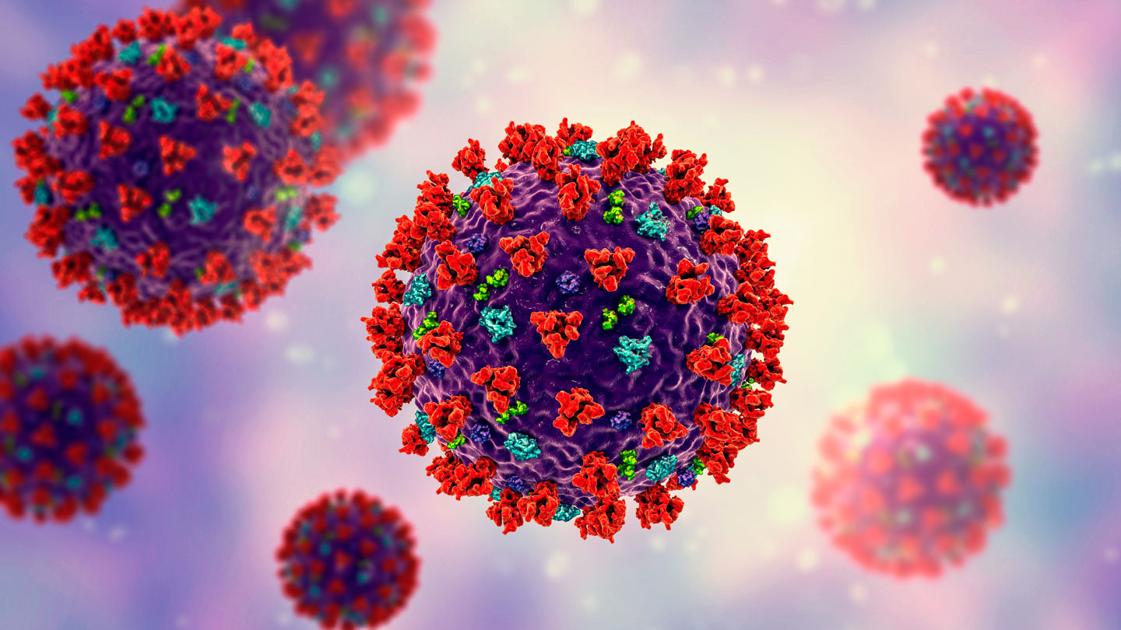

Introduction
Covid-19 has had a profound impact globally, and India has been significantly affected by the pandemic.
This project focuses on analyzing Covid-19 data specific to India, providing insights into the spread of the virus and the vaccination efforts undertaken in the country.
There are included 2 data tables in CSV:
Table 1 (Covid-19 India) includes essential data points such as Date, Time, State/UnionTerritory, Cured cases, Deaths, Confirmed cases, and Active Cases.
Table 2 (Covid Vaccine Statewise) contains information about vaccine administration in different states of India.

Slide 4

Goals / Business Requirement
Objective:
To fulfill the business requirements efficiently and effectively, the following goals have been outlined:
Python Proficiency:
Gain proficiency in Python for effective data analysis.
Summary Table:
Create a concise summary table for State/UnionTerritory, case status, recovery rate, and mortality rate.
Key Metrics Presentation:
Highlight top 10 active cases, highest deaths, and top 5 affected regions.
Vaccination Analysis:
Analyze gender-based vaccination distribution and identify top 3 vaccinated regions.

Slide 5
Methods of Implementation
1. Tool Setup | Install Anaconda and utilize Jupyter Notebook for streamlined coding and analysis environment.
2. Initialization | Define project scope and objectives to establish a clear direction for analysis.
3. Business Requirement Identification | Identify key business requirements and translate them into analytical tasks.
4. Implementation Strategy | Execute data analysis tasks using Python libraries such as Pandas, NumPy, and Matplotlib for data manipulation, analysis, and visualization.
5. Documentation | Document code, analysis steps, and findings for reproducibility and future reference.
6. Quality Assurance | Perform data validation and quality checks to ensure accuracy and reliability of results.
7. Iterative Refinement | Refine analysis based on feedback and iterate as necessary to meet project objectives.

Slide 6
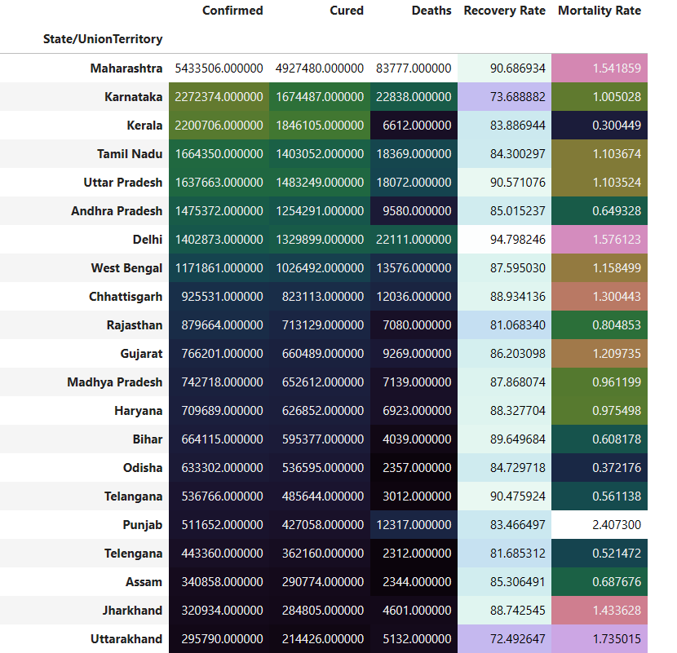
Results - Table
Summary table for State/UnionTerritory, case status and rate.

Slide 7
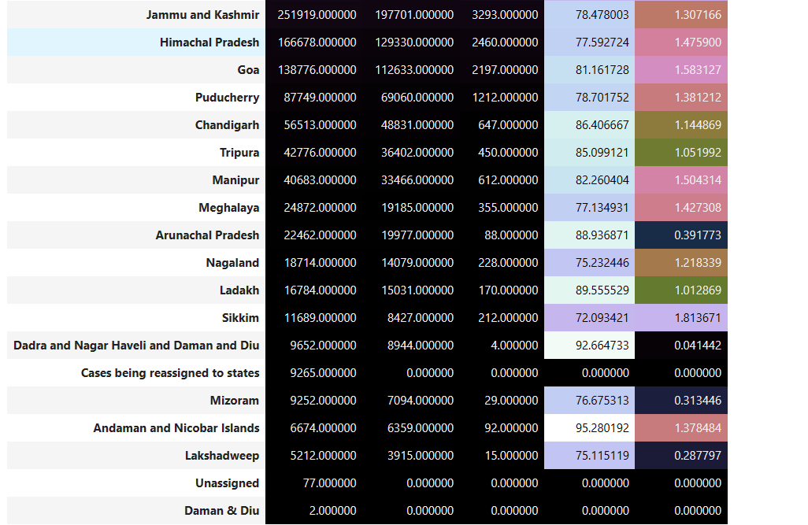
Results – continue table
Summary table for State/UnionTerritory, case status and rate.

Slide 8
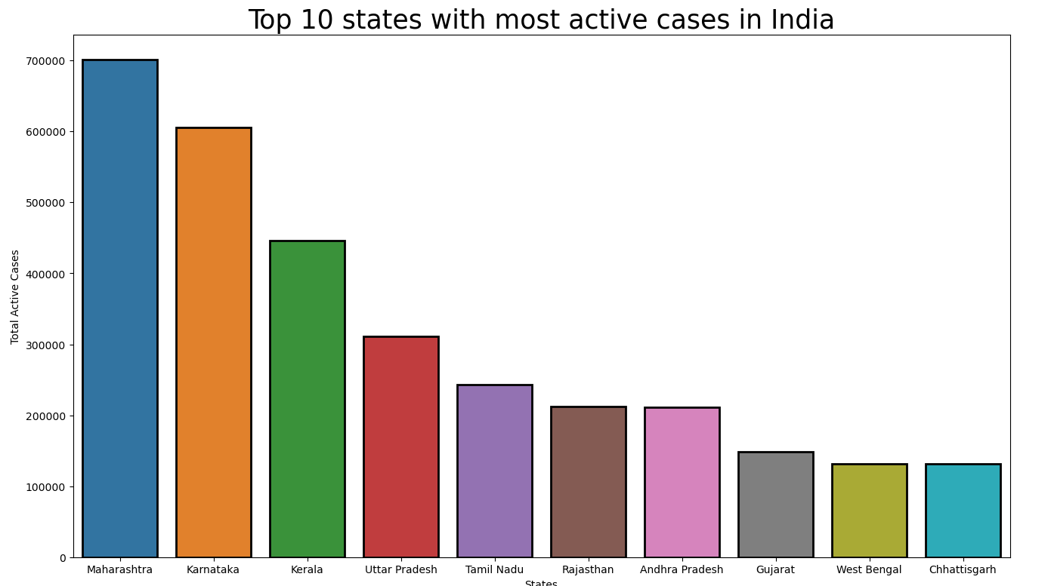
Results – bar chart

Slide 9
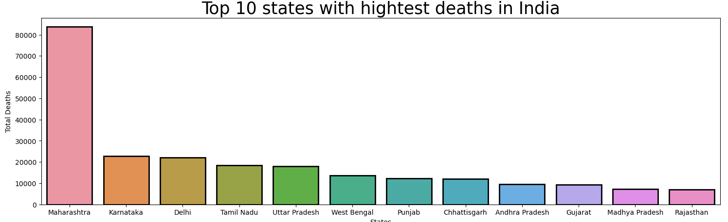
Results – bar chart

Slide 10
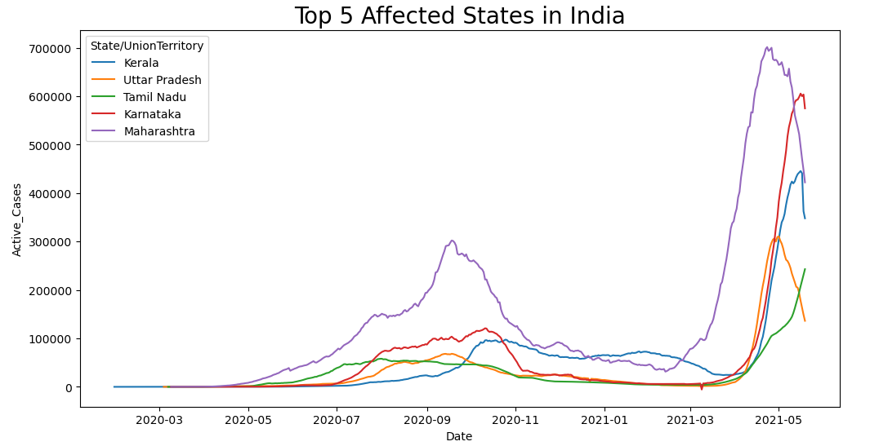
Results – line chart

Slide 11
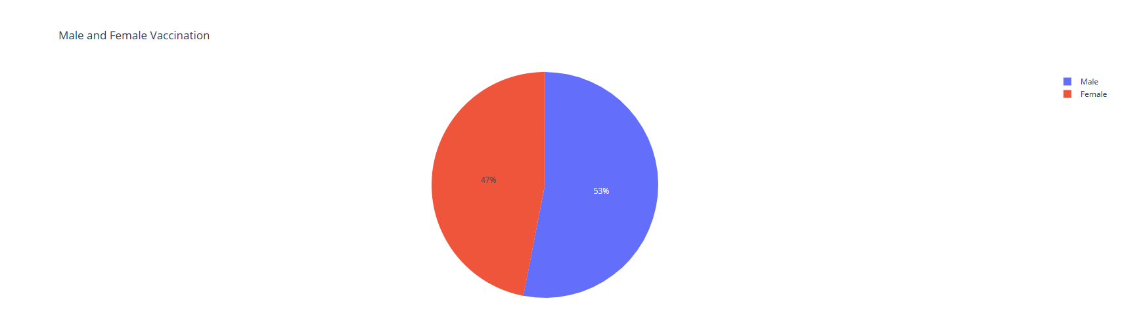
Results – pie chart
Gender Vaccination

Slide 12
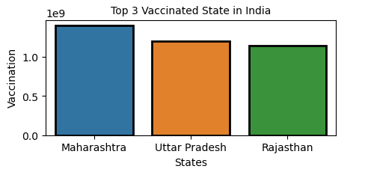
Results – bar chart
Top 3 Vaccinated State in India
Output Link:

Slide 13
Thank you

